Slide 1
Population Aging and the Generational Economy: A Global Perspective
Ronald Lee and Andrew Mason
Lead authors and editors

Slide 2
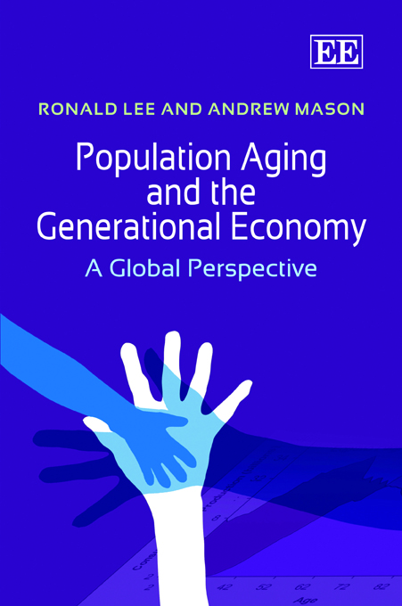
After more than a hundred articles by project members, the first book from the project is out.
Reflects the efforts of 50 researchers around the world who are on NTA country teams or who have assisted and trained country teams.
Seven years to complete.
Available from Edward Elgar in hard or paper cover.
Free download courtesy of IDRC.
Links on www.ntaccounts.org

Slide 3
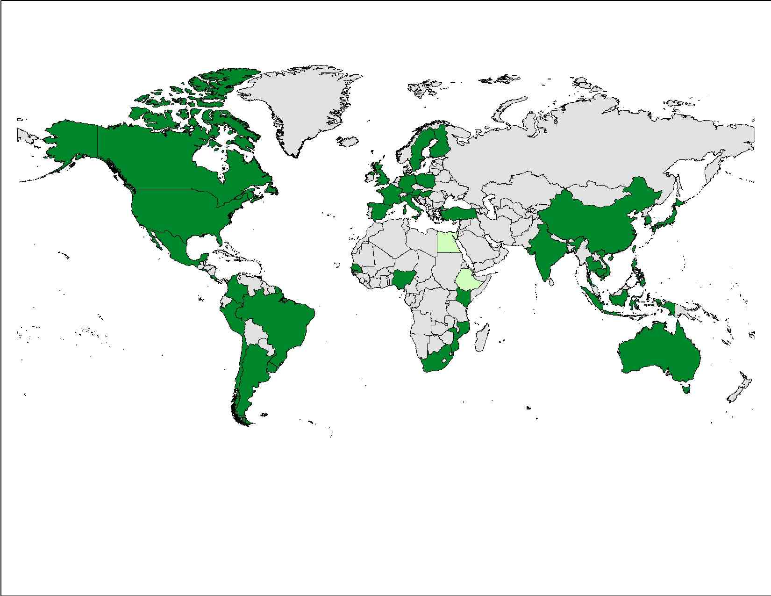
Geographic coverage of NTA and current members
NTA Members
Asia-Pacific | Americas | Europe | Africa
Australia | Argentina | Austria | Egypt*
Cambodia | Brazil | Finland | Ethiopia*
China | Canada | France | Kenya
India | Chile | Germany | Mozambique
Indonesia | Colombia | Hungary | Nigeria
Japan | Costa Rica | Italy | Senegal
Philippines | El Salvador | Poland | South Africa
South Korea | Jamaica | Slovenia
Taiwan | Mexico | Spain
Thailand | Peru | Sweden
Vietnam | United States | Turkey
 | Uruguay | United Kingdom | *Pending

Slide 4
This continuing effort has been supported by many funders
National Institute on Aging (NIA)
Bill and Melinda Gates Foundation
International Development Research Center (IDRC), Canada
UN Fund for Population Activities (UNFPA)
UN Population Division
East-West Center, Hawaii
Center for the Economics and Demography of Aging, UC Berkeley
Japan: MEXT.ACADEMIC FRONTIER
MacArthur Foundation
European Union
In-country support from governments and other funders in many countries.

Slide 5
National Transfer Accounts (NTA)
Describes the age patterns of economic activity and the economic relations between the generations.
Quantifies how each age groups acquires and uses economic resources.
Constructed using existing data (population estimates, surveys, administrative records, macroeconomic data).
Consistent with UN System of National Accounts.

Slide 6
Two illustrative examples
Cost of children in high fertility countries and the implications for human capital spending.
Funding old-age needs: relying on labor income, transfers, and assets.

Slide 7
Children are a heavy economic burden in many developing countries
High fertility in developing countries has led to very young populations.
A large portion of what adults are producing is going to meet the material needs of their children.
Most is going to meet basic needs like food, clothing, and housing.
Little remains for health and education for children.

Slide 8
Economic lifecycle flows for Nigeria, per capita values

Slide 9
Aggregate flows, Nigeria
Net cost of children (<25) is 87% of the total labor income of adults 25+.
Net cost of elderly is very small.

Slide 10
Human Capital Spending, Nigeria
Only 20% of spending on children goes to human capital (health and education)

Slide 11
Fertility/human capital tradeoff
Updated from NTA database www.ntaccounts.org accessed March 20, 2013.

Slide 12
In countries with lower fertility . . .
Children claim a much smaller share of the nation’s production.
More can be devoted to raising human capital spending per child.
More can be used to raise standards of living and to reduce poverty.
More can be saved and invested in the future.
But low fertility eventually leads to populations with high rates of old-age dependency.

Slide 13
The US Economic Lifecycle, Aggregate Flows (2003)

Slide 14
US Economic Lifecycle, 65+
Labor income

Slide 15
Old-age Funding System, US
Asset-based flows
Labor income

Slide 16
Old-age Funding System, US
Funding of old-age consumption
Labor income 16.4%
Assets 58.3%
Transfers 25.2%
Public 31.9%
Private - 6.6%
Transfers
Asset-based flows
Labor income

Slide 17
Old-age Support System NTA Countries
Key tradeoff: transfers versus assets.
IN
US relies heavily on assets.
ID
US
MX
Heaviest reliance on transfers is in Europe.
DE
UY
Latin America and East Asia are similar in their reliance on transfers, but public dominates in LA and private important in EA.
CR
SI
BR
CN
HU

Slide 18
Concluding Remarks
Our economic systems are being tested by unprecedented changes in population age structure.
Stakes are very large: economic growth, generational equity, economic security for children and elderly, and sustainability of support systems.
Complex systems are involved: governments, labor markets, families, financial markets, and health care systems.
Essential that policy be informed by the best possible data linking population and the macroeconomy.

